Slide 1
UGBA 141 Production and Operations Management
SCM III Quick Response + Contracts
Professor Park Sinchaisri

Slide 2

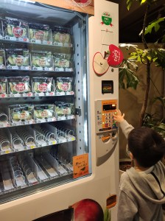
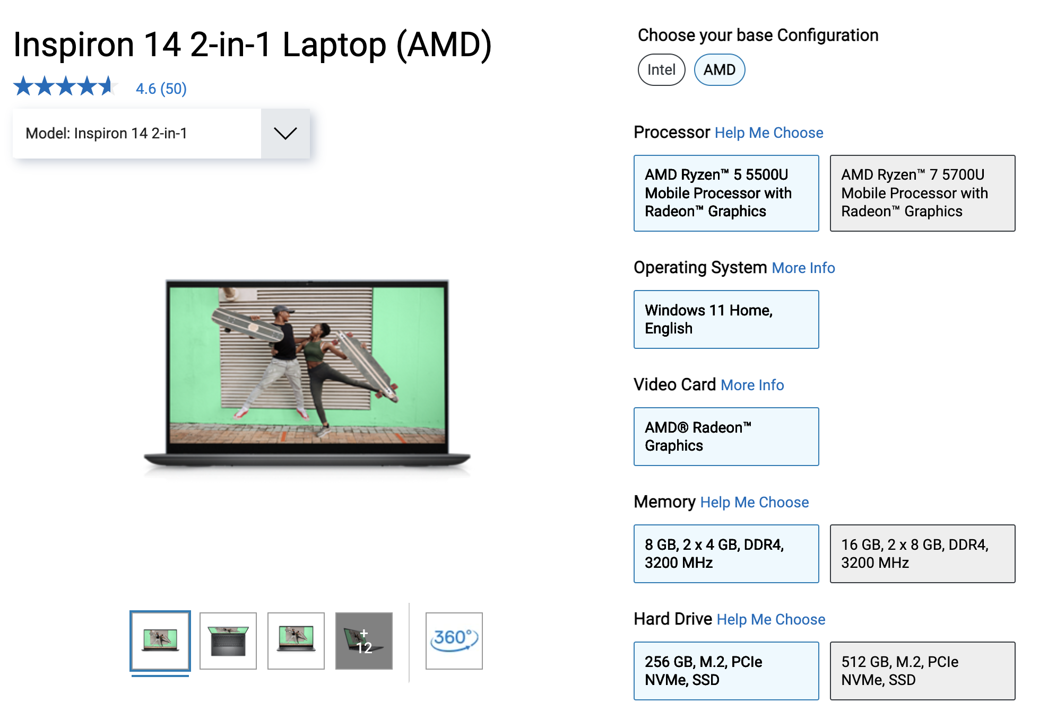
Made-to-Stock vs to-Order
$$−1∗P\left(Demand≤Q\right)∗L+\left(1−P\left(Demand≤Q\right)\right)∗G=G−\left(G+L\right)∗P(Demand≤Q)$$
Made-to-Stock (MTS)
= This is Newsvendor!
Quick Response
Made-to-Order (MTO)
Delay production until better demand information is learned
Assume lead time is short relative to the length of the selling season
Quick Response = capability to place multiple orders during a selling season
1st order: conservative early order
Observe early season sales
2nd order: strategically respond to sales

Slide 3


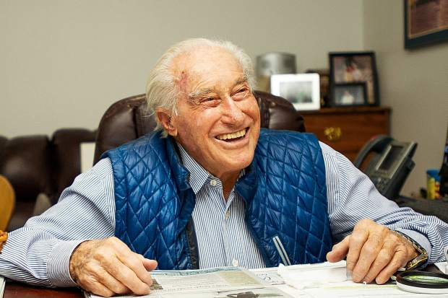

Obermeyer Background
High-end fashion skiwear based in Aspen, Colorado
Most of its critical outerwear are sourced from China + Hong Kong
First down parka, mirrored ski goggles, suntan lotion, plastic boots, turtlenecks with elasticized collars, 2-prong ski brakes, and more
It’s November 1992, Wally Obermeyer has to make a decision about what production quantities to commit to for ‘93-’94 season.
Why is this problem difficult?
Wally Obermeyer
102-year-old Klaus Obermeyer
Founder and CEO
Notes:
the first plastic ski boot, the first down parkas, mirrored sunglasses and the turtleneck
The quilted down parka, stitched together from his own down comforter.
The first mirrored ski sunglasses from vaporized metal.^{[3]}
The first nylon windshirt.
With Friedl Pfeiffer, the first high-altitude suntan lotion.^{[4]}
A dual-layer ski boot, the first with a warm liner and rigid exterior shell.
The first turtlenecks with elasticized collars.
The 2-prong ski brakes.

Slide 4
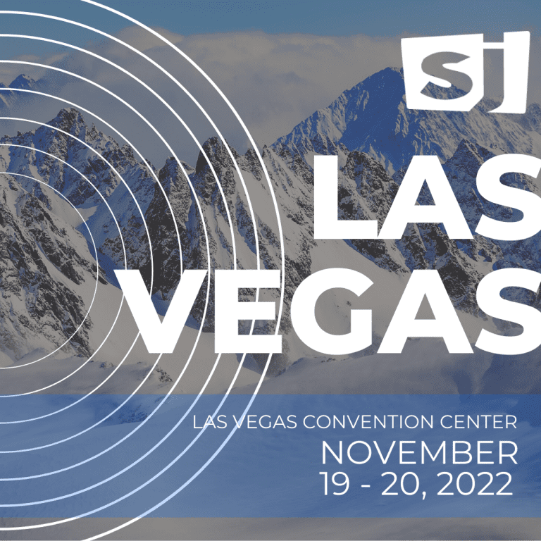
Obermeyer Production Timeline
9/92
10/92
11/92
12/92
1/93
2/93
3/93
4/93
5/93
6/93
7/93
8/93
Las Vegas
1st Prod. Order
2nd Prod. Order
Delivery
Speculative capacity
Reactive capacity
Speculative capacity (China)
Must be used before Las Vegas orders
Best available information is the buying committee’s forecasts
Limited capacity (10,000 units)
Reactive capacity (Hong Kong)
Available after Las Vegas orders
Demand is known with certainty
Limited capacity (10,000 units)

Slide 5
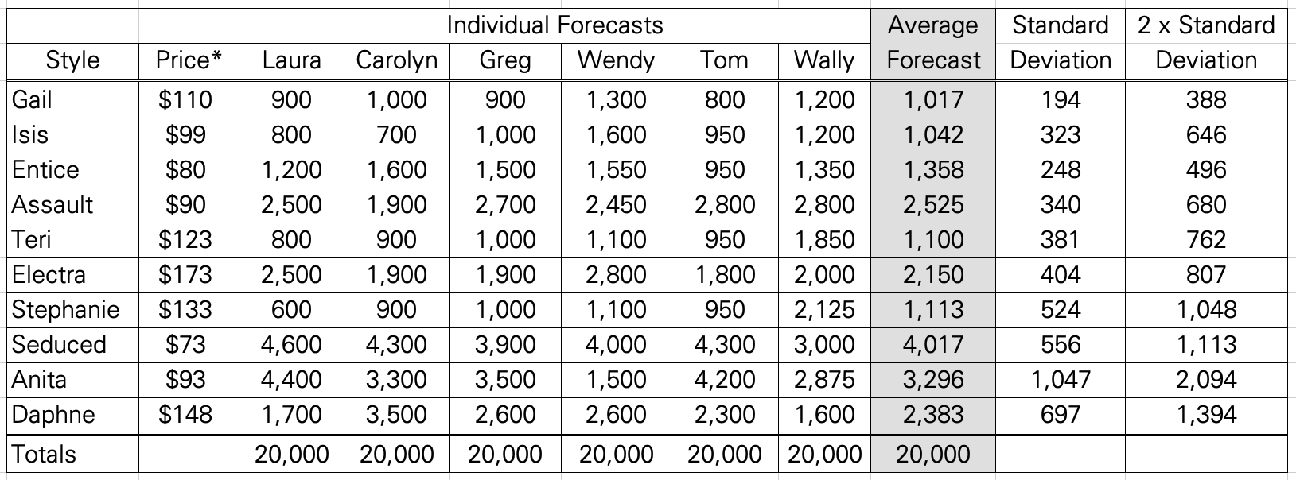
Obermeyer Expert Forecasts
(Exhibit 10)
Gain if product is sold is 24% of wholesale price
G = 0.24 × wholesale price
Loss if product is not sold is 8% of wholesale price
L = 0.08 × wholesale price

Slide 6
Unconstrained Speculative
Assuming zero reactive capacity but infinite speculative capacity
This is the classical newsvendor model!
Ex. Gail style (price = $110, mean forecast = 1,017, SD = 388)
Gain if sold is 24% of price / Loss if not sold is 8% of price
G = 0.24 x $110 = $26.4
L = 0.08 x $110 = $8.8
Critical Ratio = G/(G+L) = $26.4 / ($26.4 + $8.8) = 0.75 ← SL
z* from the Standard Normal CDF table: 0.68 (Excel: 0.67449)
Q* = μ + z*𝜎 = 1,017 + 0.68 x 388 = 1,281 units
Notes:
G = 0.24 x $110 = $26.4
L = 0.08 x $110 = $8.8
Critical Ratio = G/(G+L) = $26.4 / ($26.4 + $8.8) = 0.75 ← SL
z* from the Standard Normal CDF table: 0.68 (Excel: 0.67449)
Q* = μ + z*𝜎 = 1,017 + 0.68 x 388 = 1,281 units
So want to set Q so that:
P{D ≤ Q} = (0.24w)/(0.24w + 0.08w) = 0.75
(75th percentile each product’s demand dist’n)
So-called “equal fractile (percentile)” policy

Slide 7
Constrained Speculative
Assuming zero reactive capacity, speculative capacity is limited to 10k
How to allocate limited capacity?
Scaling the quantity based on demand forecast (mean)
Proportional scaling from newsvendor
Equal ratio policy: same service level, z-score
Focus on trustworthy forecasters
Equalize incremental contributions

Slide 8
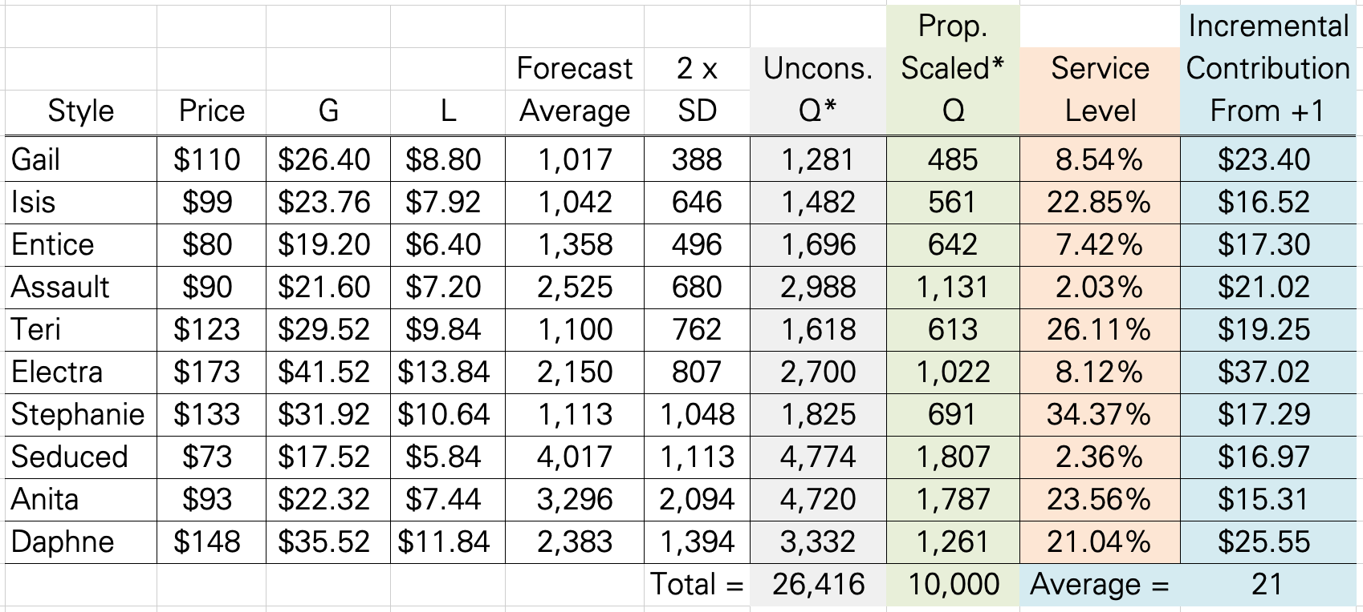
Constrained Speculative
Proportional scaling from Newsvendor (ratio = 0.75, z* = 0.68)
Gail: Q* = 1,281, total = 26,416
→ Scaled Q* = 10,000 x 1,281 / 26,416 = 485
What is our service level now?
P( Demand ≤ 485 ) = P( z ≤ (485 – 1,017)/388 ) = P( z ≤ -1.3711)
= 0.0853 = 8.53%
IC = G x [1 – P( Demand ≤ 485 )) – L x P( Demand ≤ 485 )
$26.40 x 91.47% - $8.80 x 8.53% = $23.40
NORMDIST(Q, mean, std. dev., true) in Excel
or obtained by using Standard Normal Table

Slide 9
Constrained Speculative
Proportional scaling from Newsvendor
Equal ratio policy same SL/z for all products
Simple policy; good for set of similar products
Considers quantity risk, but not risk due to prices
Better: Allocate production to equalize ICs!

Slide 10
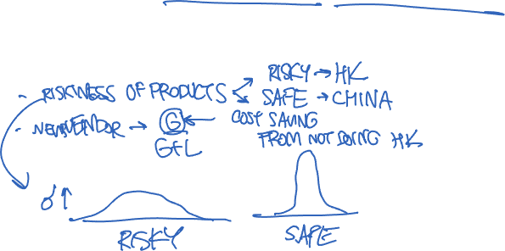
Obermeyer Two Productions
The actual scenario: speculative in China, reactive in Hong Kong
Tradeoff: order cheaply now but may have excess inventory
OR order later at higher cost
What should we do?
Notes:
Risk-based production planning
Same as before, but now the GAIN includes the saving from the high cost production in Hong Kong
Example: Rococo
loss on salvage = C_{o}=.08 ($112.50) = $9
extra cost from HK = C_{u}= $11.76
Gain is now the saving of the cost!
So set P{D ≤ Q} = 11.76 / (11.76 + 9) = 0.566 (approx. 57th percentile)
Order approx. mean quantity from China; remainder, if needed, from HK

Slide 11
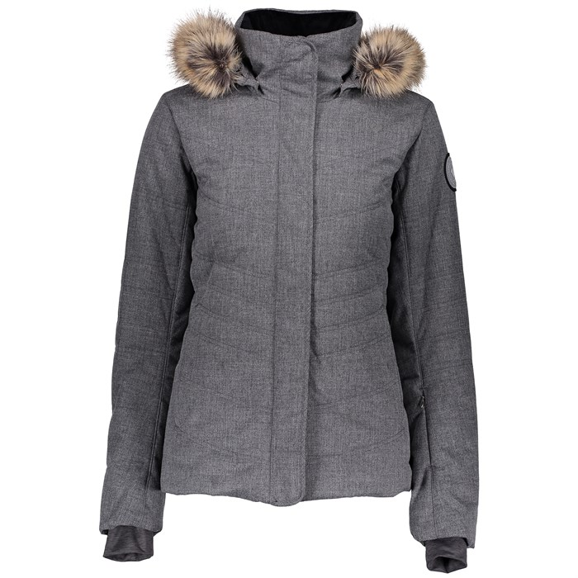
Obermeyer Value of Info
Example: The Gail Style ($110)
Made-to-stock (speculative)
G = 0.24p, L = 0.08P
Critical ratio = 0.75, z* = 0.68
μ_{GAIL} = 1,017, 𝜎_{GAIL} = 388
Q* = μ_{GAIL} + z* 𝜎_{GAIL} = 1,281
E[Profit] = G x E[Sales] – L x E[Leftovers]
= 0.24 x $110 x (1,281 – 388 x 0.8278) – 0.08 x $110 x (388 x 0.8278)
= $22,512.64
Made-to-order (reactive)
If demand is D, produce exactly D
Profit = G x D
E[Profit] = G x E[D]
= G x μ_{GAIL}
= 0.24 x $110 x 1,017
= $26,848.80
Expected value of perfect information (EVPI)
= $26,848.80 - $22,512.64 = $4,336.16
Notes:
E[Profit] = G x E[Sales] – L x E[Leftovers]
= 0.24 x $110 x (1,281 – 388 x 0.8278) – 0.08 x $110 x (388 x 0.8278)
= $22,512.64

Slide 12
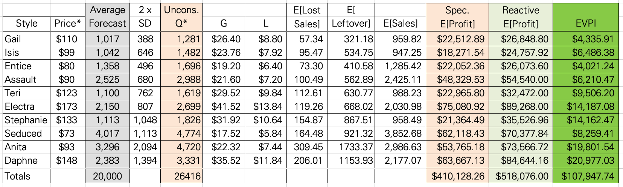
Obermeyer Reactive EVPI
Value of Reactive Production
How much are you willing to invest to get perfect information?

Slide 13
Obermeyer Improvements?
Reduce lead time
Vertical integration
Increase component commonality: zippers, color palette
Delayed differentiation
Improve forecasting process
Use historical sales of similar styles
Get information earlier
Test runs
User interviews

Slide 14
Obermeyer Takeaways
How to adapt newsvendor calculations to find order quantities when there are realistic complications/constraints
Quick Response: Effect/value of reactive capacity on initial runs
Quantify uncertainty: Forecast distributions, not just means
Make intelligent gambles by applying the critical ratio method
Reduce uncertainty: Improve/update forecast accuracy
Avoid uncertainty: Use reactive capacity for risky products
Increase effective reactive capacity
Hedge against residual uncertainty:
Hold generic components and postpone final production

Slide 15
Supply Chain Contracts

Slide 16


Contracts in Abstract Sense
A contract is a (legal) agreement between a buyer and a seller that defines the terms and conditions of sales
Contracts
Demand
Production cost = C / unit
Retail price = p / unit
Why contracts?
Reduce uncertainty, help to share risk, incentivize sales effort, important for information sharing

Slide 17
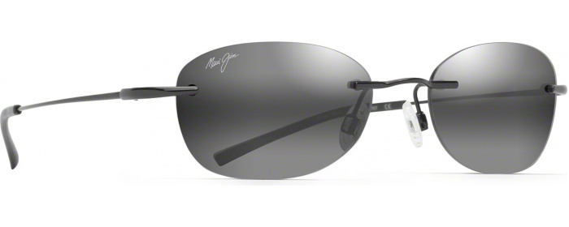


Wholesale Contracts
“Sugar Beach”
short selling season
Wholesale
Demand
~ Normal
(250,125)
Palo Alto, CA
Wholesale price = $75
Production cost = $35
Retail price = $115
Salvage value = $25
All frames and lenses manufactured in Italy/Japan
Long lead time
One delivery of glasses before each season

Slide 18
Wholesale Retailer’s Q*
SS’s quantity decision can be made using the newsvendor model
G = $115 - $75 = $40 L = $75 - $25 = $50
Critical ratio = $40 / ($40 + $50) = 4/9 = 0.4444 → z* = -0.13
Q* = 250 – 0.13 x 125 = 234 units
SS’s profit = G x E[sales] – L x E[leftover] I(-0.13) = 0.3373
= $40 x (234 – 125 x 0.3373) - $50 x (125 x 0.3373)
= $5,580 (rounding leftover to 42 units)
MJ’s profit = 234 x ($75 - $35) = $9,360
SC total profit = $5,580 + $9,360 = $14,940
Notes:
SS’s quantity decision can be made using the newsvendor model
G = $115 - $75 = $40 L = $75 - $25 = $50
Critical ratio = $40 / ($40 + $50) = 4/9 = 0.4444 → z* = -0.13
Q* = 250 – 0.13 x 125 = 234 units
SS’s profit = G x E[sales] – L x E[leftover] I(-0.13) = 0.3373
= $40 x (234 – 125 x 0.3373) - $50 x (125 x 0.3373)
= $5,580 (rounding leftover to 42 units)
MJ’s profit = 234 x ($75 - $35) = $9,360
SC total profit = $5,580 + $9,360 = $14,940

Slide 19







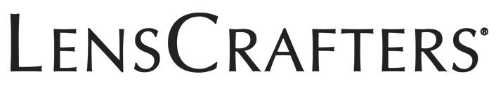


Wholesale Vertically Integrated
Still a newsvendor
G = $115 - $35 = $80
L = $35 - $25 = $10
Critical ratio = 80/90 = 0.8889 → z* = 1.23
Q* = 250 + 1.23 x 125 = 404 units
SC profit = $17,830
19% higher than before!
+
Demand
~ Normal
(250,125)
Retail price = $115
Production cost = $35
Salvage value = $25

Slide 20
Wholesale Double Margin
Q = 234
SS profit = $5,580
MJ profit = $9,360
SC profit = $14,940
WS
+
Q = 404
SC profit = $17,830
$35
$75
$115
$35
$115
Why did the original contract perform worse?
SS doesn’t order enough (234 instead of optimal Q = 404)
From SS’s perspective, it doesn’t matter if the actual production cost is $35, $55, or even $0; its “production cost” is $75.
Double Marginalization + lack of coordination

Slide 21



Buy-Back Contracts
Wholesale price = $75
Wholesale
Buy-Back
Demand
~ Normal
(250,125)
Buy-back price = $75
Palo Alto, CA
Shipping
Production cost = $35
$1.50
Retail price = $115
Salvage value = $25
Notes:
Most effective for products with low variable cost, such as music, software, books, magazines, and newspapers
ฎ?ณ

Slide 22
Buy-Back Profits
Demand ~ N(250,125)
Retail price = $115
WS price = $75
BB price = $75
Production cost = $35
Shipping = $1.50
MJ salvage = $25
With BB: For SS,
Gain is still $115 - $75 = $40
Loss is now just $1.5 (shipping)
MJ effectively incentivized SS to increase Q
G
40
=
= 0.9639
z* = 1.8
G+L
40 + 1.5
But this is larger than optimal Q!
Q* = mu + z* x sigma = 250 + 1.8 x 125 = 475
SS’s expected profit = $9,580 (increased from $5,580 without refunds)
MJ’s expected profit = $7,991 (decreased from $9,350 without BB)
SS’s expected leftover = 125 x I(1.8) = 227

Slide 23
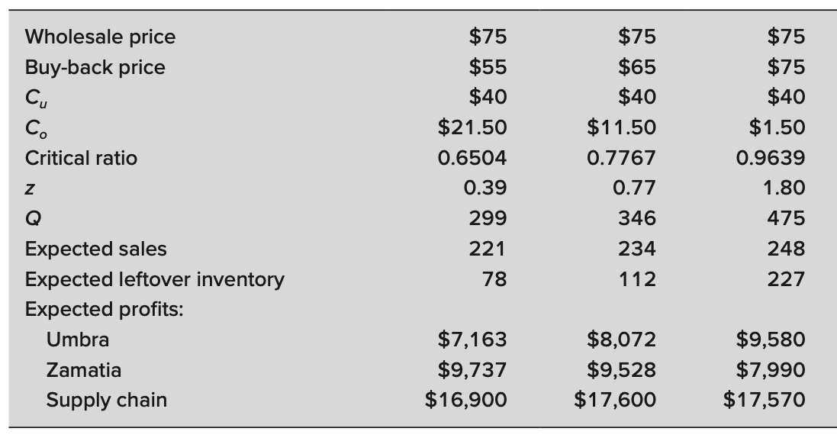
Buy-Back Good BB Prices
Without BB
With BB
$75
= gain
= loss
Solstice Sunglasses (SS)
$5,580
Maui Jim (MJ)
$9,360
$14,940
G
40
=
= 0.9639
z* = 1.8
G+L
40 + 1.5

Slide 24
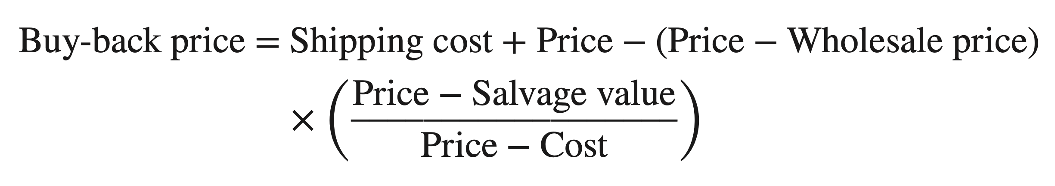
Buy-Back Optimal BB Price
Set BB price such that total SC profit is maximized:
Retailer’s critical ratio = SC’s critical ratio
Price – Wholesale price = Price - Cost
Price – (BB price - Shipping cost)
Price – Salvage Value

Slide 25
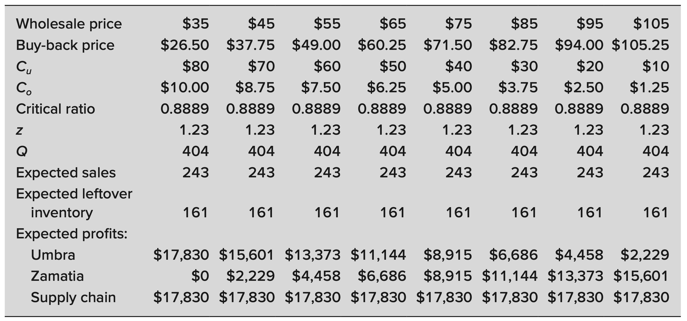
Buy-Back Optimal BB Price
Demand ~ N(250,125)
Retail price = $115
WS price = $75
BB price = $75
Production cost = $35
Shipping = $1.50
MJ salvage = $26.50
What’s the optimal BB price?
BBP = $1.5 + $115 – ($115 - $75) x ($115 - $25)/($115 - $35) = $71.5
Both firms split $17,830 profit, but MJ is worse off!
$75
$35
Without BB
= gain
= loss
Solstice Sunglasses
$5,580
$17,830
Maui Jim (MJ)
$9,360
$0
$14,940
$17,830
Price – Wholesale price = Price - Cost
Price – (BB price - Shipping cost)
Price – Salvage Value

Slide 26
Contracts Summary
Good contracts can improve supply chain performance
Working together with others in the SC can help increase the size of the “pie”, even if your slice is proportionally smaller
Buy-Back Contract:
Many different (W,B) that achieve 100% efficiency
Increasing one’s profit = the other’s profit decreases… But now the sum they can fight over is maximum possible!
Downsides:
Requires manufacturer to verify leftover units
May reduce retailer’s selling effort

Slide 27


What’s Next
HAPPY SPRING BREAK! ☺
No Friday Discussion this week
Midterm Regrade Request on Gradescope by Friday 2pm
After the break
Monday: Amazon (report due the night before)
We’ll have a guest speaker from Amazon!
Wednesday: Google (report due the night before)
Read Uber as well
Sunday: One-page brief update report

Slide 28
Appendix

Slide 29
Other Contracts
Flexible Quantity
Manufacturer places an order at the beginning of the season, but the quantity can be adjusted up or down
Also encourages higher ordering quantities
Examples: Fashion industry
Revenue Sharing
Manufacturer receives some fraction of sales revenue
Both share risk due to demand uncertainty
Example: Blockbuster

Slide 30
Accurate Response Model
Forecast distribution of demand
Assess product economics:
Gain from stocking an additional unit and selling it
Loss from stocking an additional unit and not
selling it
Determine appropriate initial production quantities
What kinds of products to produce early vs. late?
Read early demand indicators
Update demand forecast
Determine final production quantities

Slide 31
Thinking More about Risk

Slide 32
Product-SC Matrix
What is the right supply chain for your product?
 |  |  | Product type
 |  |  | Functional | Innovative
 |  |  | Predictable demand (low Var) Long (2+ years) life cycle Small margin (5-20%) | Unpredictable demand (high Var) Short (3-12 month) life cycle Large margin (30-60%)
Supply chain type | Efficient | Low unit cost Long lead time | Mostly China, then HK only if updated forecasts warrant Match | Baseline quantity from China and Hong Kong Unmatch
 | Reactive/ Responsive | High unit cost Short lead time | Mostly China; some HK for very expensive items Unmatch | HK only Match

